Slide 1
The Family Reunification Model©
Kelly N. Bako, MSEd., LPCC
© Copyright 2010

Slide 2
The FRM for Clinicians

Slide 3
The Family Reunification Model ©: Micro to Macro Application
Goal: Improve Clinical Service Delivery by providing advanced clinical training for child-family serving providers
Objective 1: Educate providers on the clinical process
Objective 2: Educate providers on the continuum of care, spectrum of interventions, & RTC
Objective 3: Educate providers on how to maximize the impact of their clinical role

Slide 4
Continuum of Competencies
Lack of Awareness
Awareness
Invested Awareness
Initiative
Action
Skill Development
Competency
Promotion of Awareness/Skill Development in others

Slide 5
Spectrum of Interventions
Least Restrictive
Most Restrictive

Slide 6
Continuum of Care
No Help
Outpatient
IOP
Screening
Pastoral/Natural supports
Self Help
No Help is better than the wrong help
Clients will often try to “self-correct”
Clients may reach out to natural supports before formal supports
Primary Care, School Settings, ER often are 1st screeners
Clients may access OP but only for short duration (immediate relief)

Slide 7
Continuum of Care, cont.
Respite
Residential
Inpatient Psych
Goal is always to provide the least restrictive level of care or intervention(s)
However, timely & purposeful RTC intervention can yield the most effective and lasting outcomes
Improper timing and use of RTC can produce counter-therapeutic results and iatrogenic effects
Poor timing of RTC use as an intervention can be costly on a system of care

Slide 8
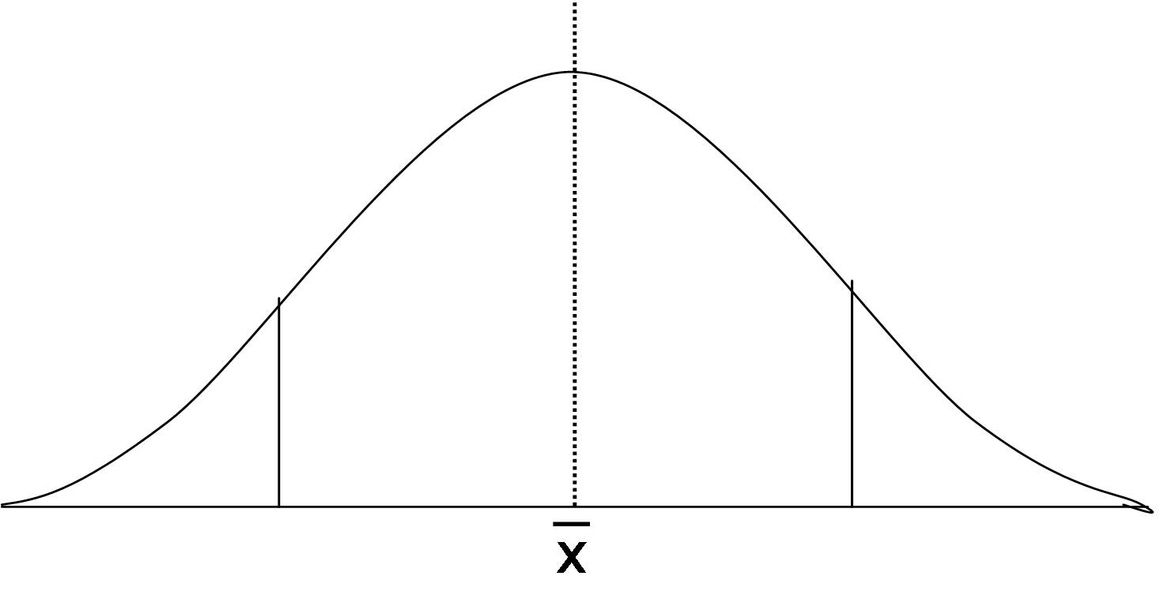
Clinical Process
Beginning, Middle End
Assessment/Engagement, therapeutic alliance and therapeutic work, termination and stepping down
Each phase has its own unique therapeutic work or “focus”
Each phase has its own unique client/family challenges
Clinical provider leads the clinical process
Clinical Principles
Therapeutic work cannot be forced; “can lead a horse to water…”
{FRM relies on the strategic use of MI, Change Theory, Crisis Theory, engagement strategies)
Identified Client versus “real” client
Family Systems Issues {Client doesn’t exist in a vacuum}

Slide 9
Family Therapy

Slide 10
Family Therapy Overview

Slide 11
Family Systems Theory
Theories
Names to know
Interventions & Techniques

Slide 12
Interventions

Slide 13
Techniques

Slide 14
Family Therapy
Braiding Hair

Slide 17
The Family Reunification Model©; Application for Clinical Work
How to use the FRM, visual, metaphors, and interventions to maximize your clinical impact

Slide 18
The FRM

