Slide 1
It's not the big things that add up in the end; it's the hundreds, thousands, or millions of little things that separate the ordinary from the extraordinary.
Darren Hardy

Slide 2
Introduction
Creation of the Model
Purpose of the Model
The Family Reunification Model ©
Micro to Macro Applications

Slide 3
The Family Reunification Model; Promoting Efficient & Effective Residential Treatment & Service Collaboration
Kelly N. Bako, MSEd., LPCC
© Copyright 2010

Slide 4
The Family Reunification Model © 8 Phases I. Pre-Admission II. Admission III. Stabilization/Assessment IV. Mediation/ Mitigation V: Visitation/ Therapeutic Reframe VI: Transfer VII: Detachment/ Individuation VIII: Discharge
© Copyright 2010

Slide 5
Micro to Macro
Program Managers, Administrators
Clinicians & Clinical Providers
Direct Care Staff
Kids & Families
Community Stakeholders, Funding Sources

Slide 6
The Big Picture
A Residential Treatment Center that utilizes a model is more organized, synchronized, and effective in its services delivery and outcomes.
Trained Providers provide better services.
Trained Providers are better at engagement, treatment planning, and service delivery, which results in more positive outcomes for the child and family.
A Trained system of care uses its resources wisely and effectively, optimizing its outcomes.
A trained company can provide data to its reimbursement sources, documenting its effectiveness.

Slide 7
Why? With lack of a comprehensive and coherent clinical treatment model, the reunification (or re-integration) process (and its outcome) is often vulnerable and varied. Variability in the ability, professionalism, clinical understanding and skill set of the caseworker (s), counselor (s), Service Providers, and Decision Makers, in addition to incongruent Organizational Policy and Procedure, creates unnecessary inconsistency. This leaves treatment outcomes vulnerable and varied for the children and families we serve.

Slide 8
Using the FRM© as a tool, it has micro to macro level applications to enhance service delivery in effort to improve outcomes for children and families.
Who can benefit:
Children and families
Direct Care Staff
RTC Program Administrators, Managers, Clinical Supervisors
Community Collaborators
Community Stakeholders

Slide 9
How will the FRM model help children and families?
Consumers need a clear understanding of the process.
Consumers benefit from visuals, metaphors, past success stories (Eells, 1997; Meier, 1999, 2003).
Consumers benefit from planned treatment; they should be certain as to what is expected of them and what their family can expect to experience.
Consumers are more likely to be engaged in services when they are an active, invested participant (Lindqvist,2010).

Slide 10
How will the FRM model help children and families?
Consumers can speak a common language.
Visual Model is like Map Quest; Start, finish, and specific directions in between to get to the destination.
Knowing what to expect helps families plan ahead.
Knowing what to expect can empower children and families to engage.
The Treatment Process won’t be something that is “done to them” or “happens to them”; but rather a process they participate in and, ideally, take ownership of.

Slide 11
Something to think about…
If you don’t have a visual model for your program or services, is there a way to change this?

Slide 12
Parking Lot
What are you hoping to gain from this presentation?

Slide 13
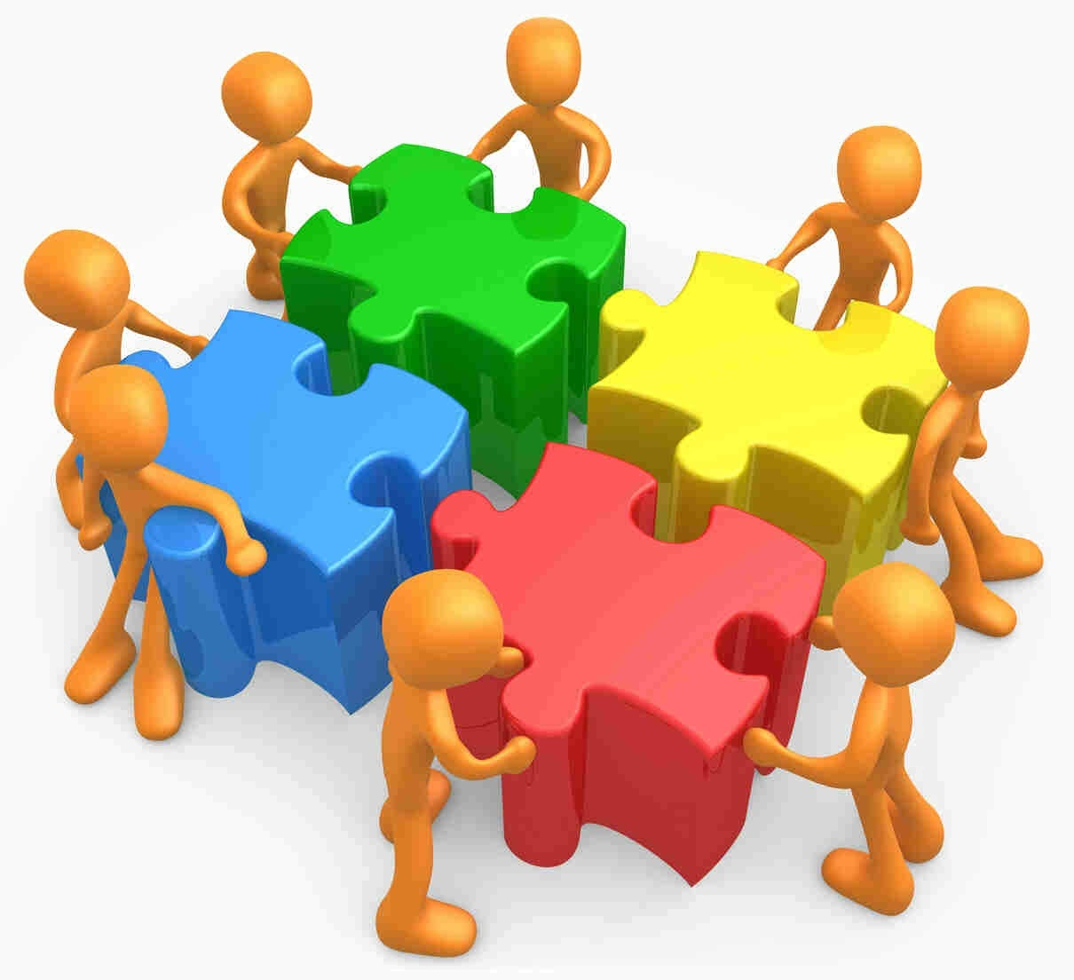
Collaboration
Happens inside and outside a RTC
This Photo by Unknown Author is licensed under CC BY

Slide 14
Who’s Who?
Direct Care Staff
Clinicians & Clinical Directors
Residential Program Managers
Community Mental Health Providers
Executives
Community Partners
Insurance Companies
Others?

Slide 15
Collaboration
Takes people, trust, and follow through
Shared Vision & Goals
Flexibility
Humility
Honor strengths and talents
Identify the gaps in your service or knowledge areas; find ways to bridge the gaps

Slide 16
Service Collaboration
Thoughts…
What is/are the most important piece(s) of service collaboration?
What is/are the most important piece(s) when it comes to service collaboration in residential?

Slide 17
Continuum of Competencies
Derived from the 4 Stages of Learning (N. Burch,1970)
Unconscious incompetent
Conscious incompetent
Conscious competent
Unconscious competence

Slide 18
Continuum of Competency using FRM
Use the model to help you identify areas of challenge/opportunity
How well are your staff/clinicians trained in understanding the overall therapeutic process of treatment, stepdown, and reintegration?
When to focus on the right things, at the right time, with the right interventions

Slide 19
Continuum of Competencies
See handout
Where are you?
Your agency?
Your community?
What steps could you take to move further toward increased competency?

Slide 20
Residential Treatment Service Delivery & Collaboration
Efficiency is doing the thing right
Effectiveness is doing the right thing

Slide 21
Residential Treatment Service Delivery & Collaboration
What is the RIGHT thing to do? (Effective Tx)
Describe doing the right thing

Slide 22
Residential Treatment Service Delivery & Collaboration
How do you do the thing right? (Efficiency)
What does it look like to do the thing right?
This Photo by Unknown Author is licensed under CC BY-SA

Slide 23
Thoughts…
What ways can your service or program become more efficient?
What ways can your service or program become more effective?

Slide 24
Pre admission
Admission
LOS
Crisis
Funding
Transfer/Discharge
Strategic Planning
Vision

Slide 25
Opportunities
Prevention (Pre-Admission) How can we collaborate within our clinical community to prevent RTX?
Admission; Orientation (kids, families, Staff) How can we collaborate to effectively engage in effort to reach maximum benefit?
Training (DCS, Clinical Providers, Collateral Contacts) How can we enhance our training to establish & maintain the most effective providers?
Length of Stay How are we collaborating with services to assure timely & effective treatment interventions to reach CE LOS?

Slide 26
Opportunities
Transition to less Restrictive Setting How are we collaborating in advance for effective step down?
Maintenance in Community/LRS How are we partnering with community providers & natural supports to enhance likelihood of successful stepdown?
Prevention How are we collaborating to prevent re-admission?

Slide 27
Prevention
Treatment
Stepdown
Training

Slide 28
People + Information+ Technology= Collaboration
Verbal
Phone (Personalization)
Email (exchange of info, non-immediate)
Texts (immediacy, use safeguards)
Documentation Sharing (Google Docs)
Dashboards, Shared Calendars
Company or Program Website
Youtube Videos
Tasks (Slack, Fidelity EHR)
Scheduling (Sling, Humanity, etc.)
Survey Monkey
LinkedIn

Slide 29
Mechanisms for Collaboration
Mechanism; natural or established process by which something takes place or is conducted
-an assembly of moving parts performing a complete functional motion, often being part of a large (machine); linkage.
People
Meetings
Service Coordination (Hi-Fidelity Wraparound)
Intranets (email, messenger, shared drives)
EHRs (memo to charts, quality client records)
Releases of Information
Social Media, Agency Program Website
Forums, Panels, Events

Slide 30
Are you using the most of your resources?
What resources are you under utilizing?
What resources might you consider adding?

Slide 31
The Family Reunification Model: A Logic Model
Goal: Provide a Standardized, Coherent Conceptual Framework for Family Reunification with High Risk Families
Purpose: Improve Outcomes for Children & Families

Slide 32
The Family Reunification Model © 8 Phases I. Pre-Admission II. Admission III. Stabilization/Assessment IV. Mediation/ Mitigation V: Visitation/ Therapeutic Reframe VI: Transfer VII: Detachment/ Individuation VIII: Discharge
© Copyright 2010

Slide 33
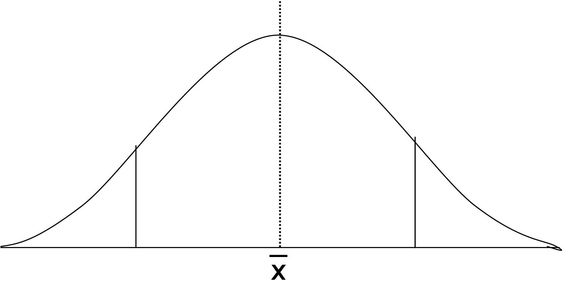
The Family Reunification Model ©
Start to finish visual aide
Externalizing the problem technique, for targeted team focus
Purposeful collaboration
Attention to critical impact points & junctures

Slide 34
The FRM & Service Delivery
Using the model & identifying strategies in each stage to:
Better train
Engage
Deliver services
Improve outcomes
Program Managers, Administrators
Clinicians & Clinical Providers
Direct Care Staff
Kids & Families
Community Stakeholders, Funding Sources

Slide 35
Model Features
Education
Engagement
Packaged Trainings
Treatment Center Handbook Guide
LOC Visual Guide
Continuum of Care Visual Guide
Parent Packet Guide
FRM Model Visual, Stages, Explanation, Expectation Packets & Info Sessions
Measure of Progress
TX Handbook
Parent Packet
Visual Guides
WJH sheets
Visitation Sheets
Behavior Plans
Safety Plans
Measure of Progress
Quarterly Progress
Discharge Criteria

Slide 36
Residential Treatment
Micro -> Macro Collaboration
Roles Training/Identified expectations
Procedures Clear/Repeated/2nd nature
Preferences Clear/When & How
Accountability Don’t drop the ball!
What are your methods for identifying/measuring efficiency or effectiveness?

Slide 37
On collaboration
People to People
Relationships
The power of having the right people in the right places, at the right time
Professionals often associate programs with people- what happens when they leave?
Meetings
If what you are doing isn’t working, change it. Don’t fall victim to the “ruts”. Cant see them? Regular habit of feedback (deliberate practice)
Sessions
Are your clinicians focused on what really matters to reach desired outcomes? Residential is complicated work.
What does a ruler, a fish finder, and a lighthouse have to do with it anyways?

Slide 38
Effective Collaboration Doing the right thing
Phone calls or Face to Face?
Phone or a text?
Individual or Group?
Session or Meeting; Duck, Egg?
Meetings
What is the action that’s going to have the most meaningful impact? Do THAT.

Slide 39
Meetings
If you must meeting, then meeting efficiently… (do the thing right)
Have an agenda, preferably an agreed upon one
Send it out in advance
Be prepared; Expect members to come prepared
Prioritize based on importance and attendance of members
Have a Timeframe (who said meetings need to be an hour? Did you know…the time you allot is the time you’ll take?)
Minute Taker; note the purpose of the action, note action plans, follow up responsibilities, deadlines
Meetings to have meetings is inefficient & often ineffective (dissolvency effect)

Slide 40
Sessions
Be clear about the purpose of the session (effective)
Efficient; G.I.R.P.P. (Bako, Bolino, Bancroft, Brutz & LePosa, 2017)
Goal, Intervention, Response, :::Course Correct:::, Progress, Plan?

Slide 41
Group
When an issue effects a group, then collaborate as a Group.
Create a safe place for members to be heard. If you cannot facilitate to create a truly open, collaborate space- hire someone who can. The quality of your outcomes is dependent.
Residents
Staff
Parents/Caregivers
Program Leaders

Slide 42
Deliberate Practice
A Special Kind of Practice. Purposeful & Systematic.
Goal is to improve performance
Ask your Clients
Ask Your Parents/Guardians
Ask your Staff
Ask your Collaborators

Slide 43
Reunifying a Family is like teaching the child and family to ride a bike… -Realize we are providing a bike (services) -Find a bike that fits the client (services/providers) -Get cl. on the bike (motivation/commitment) -Cl. Riding w/Training wheels (Supportive Assistance) -Learning to ride without training wheels (transfer of skills) -Staying on the path (maintenance) -Riding together in Unison at the same rate Reunification/Re-integration

Slide 44
Using Hi-Fidelity Wraparound to drive the process of reunification or stepdown is like riding in an SUV full of TX Providers on the Journey to Reunification or Reintegration… -Determine who has been driving? -Who should be driving? -Are they safe/legal driver? -Have we agreed on where we are going? -What kind of route are we going to take? -What kind of resources are in our car? -Who are we kicking out first? -Is everyone in the car that needs to be? -Maintaining the vehicle, etc.

Slide 45
What is the job to be done?
https://www.youtube.com/watch?v=vaN6FtJ8inA
Wraparound Ohio
https://www.wraparoundohio.org
Disruptive Innovation
https://hbr.org/video/2688242135001/the-explainer-disruptive-innovation

Slide 46
Questions, Comments?

Slide 47
Opportunities for Collaboration
I’ll Leave you with the thought…
What is the job to be done? (Clayton Christensen)

Slide 48
Contact Information
Kelly N. Bako, MSEd., LPCC
Phone: 330.509.9640
Email: thefamilyreunificationmodel@gmail.com
Website: http://www.thefamilyreunificationmodel.com/
LinkedIn: https://www.linkedin.com/in/kelly-bako-65055a56/
Facebook: https://www.facebook.com/kellybakothesource/

