Slide 1
The Family Reunification Model©
Kelly N. Bako, MSEd., LPCC
© Copyright 2010

Slide 2
THE FRM© Training for Clinical Providers
Interns
Paraprofessionals in the system of care (school personnel, aides, respite providers)
New Clinical Providers (LPC, LSW)
Clinical Providers
CW caseworkers
Direct Care Staff
Educational Support Staff

Slide 3
The Family Reunification Model ©: Micro to Macro Application
Goal: Improve Clinical Service Delivery by providing advanced clinical training for child-family serving providers
Objective 1: Educate providers on the clinical process
Objective 2: Educate providers on the continuum of care, spectrum of interventions, & RTC
Objective 3: Educate providers on how to maximize the impact of their clinical role

Slide 4
Continuum of Competencies (Kelly Bako, 2013)
Lack of Awareness
Awareness
Invested Awareness
Initiative
Action & Skill Development
Competency
Promotion of Awareness/Skill Development in others

Slide 5
Continuum of Competencies (Kelly Bako, 2013)
No awareness
Invested Awareness
Initiative
Promoting Awareness & Skill Development
Awareness
Action & Skill Development
Competency

Slide 6
Why? With lack of a comprehensive and coherent clinical treatment model, the reunification process (and its outcome) is often vulnerable and varied. Variability in the ability, professionalism, clinical understanding and skill set of the caseworker (s), counselor (s), Service Providers, and Decision Makers, in addition to incongruent Organizational Policy and Procedure, creates unnecessary inconsistency and costly outcomes.

Slide 7
Why?
A Residential Treatment Center that utilizes a model is more organized, synchronized, and effective in its services delivery and outcomes.
Trained Providers provide better services.
Trained Providers are better at engagement, treatment planning, and service delivery, which results in more positive outcomes for the child and family.
A Trained system of care uses its resources wisely and effectively, optimizing its outcomes.
A trained company can provide data to its reimbursement sources, documenting its effectiveness.

Slide 8
System of Care
Basic awareness of the clinical process, continuum of care, spectrum of interventions, and overall system of care issues improves service delivery
Advanced clinical training promotes efficiency, collaboration, and positive outcomes

Slide 9
Continuum of

Slide 10
Agenda
Welcome/ Introduction
Background
Purpose of the Model
The FRM©
Application
Question/Answers/Discussion
?

Slide 11
Activity
Who knows what a _____ does?
Who’s lane is it anyways?

Slide 12
Spectrum of Interventions
Least Restrictive
Most Restrictive

Slide 13
Activity
Your crisis

Slide 14
Continuum of Care
No Help
Outpatient
IOP
Screening
Pastoral/Natural supports
Self Help
No Help is better than the wrong help
Clients will often try to “self-correct”
Clients may reach out to natural supports before formal supports
Primary Care, School Settings, ER often are 1st screeners
Clients may access OP but only for short duration (immediate relief)

Slide 15
Continuum of Care, cont.
Respite
Residential
Inpatient Psych
Goal is always to provide the least restrictive level of care or intervention(s)
However, timely & purposeful RTC intervention can yield the most effective and lasting outcomes
Improper timing and use of RTC can produce counter-therapeutic results and iatrogenic effects
Poor timing of RTC use as an intervention can be costly on a system of care

Slide 16
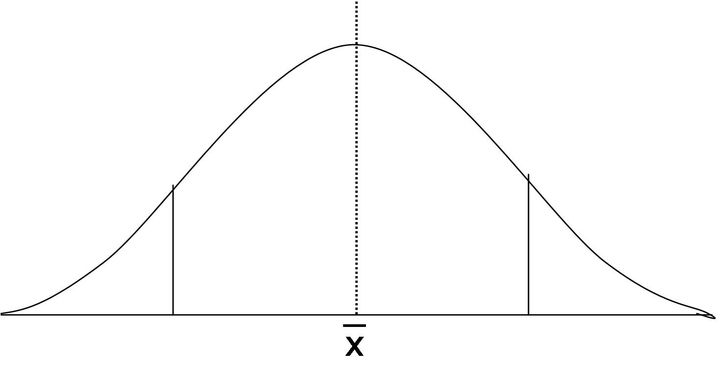
Clinical Process
Beginning, Middle End
Assessment/Engagement, therapeutic alliance and therapeutic work, termination and stepping down
Each phase has its own unique therapeutic work or “focus”
Each phase has its own unique client/family challenges
Clinical provider leads the clinical process
Clinical Principles
Therapeutic work cannot be forced; “can lead a horse to water…”
{FRM relies on the strategic use of MI, Change Theory, Crisis Theory, engagement strategies)
Identified Client versus “real” client
Family Systems Issues {Client doesn’t exist in a vacuum}

Slide 17
Residential Treatment
Beginning, Middle, and End
Also known as:
Admission (Presenting problem and criteria)
Engagement
Therapeutic Programming (Milieu)
Discharge Planning
Termination/Reintegration
Each Phase has its own unique areas of focus/tasks
Each Phase has its own unique challenges
Residential Treatment may be time limited ( 30, 90, 180, +) LOS
Admission/Discharge Criteria based on Treatment Programming and Clinical Issue Treated
LOS may also be influenced by parental decision, funding, other issues

Slide 19
Micro
Kids & Families
Utilize the visual to educate on the clinical process, the course of RTC or an intensive program
Help kids and families understand what will be expected of them at each phase
Help kids and families understand the focus/tasks of each phase, what challenges they may face, who to turn to and when, and other strategies that can be used to overcome common critical impact points of treatment

Slide 20
Children & Families Phase I
Prior to Admission:
Benefits
Risks
Common Challenges
Expectations

Slide 21
Children & Families Phase II
Admission
Learning the program rules, expectations, schedules, hierarchy
Questions & concerns
Common Fears/Resistance
Detaching from Crisis Cycle
“Vanilla” Communication and Visitation
Acclimating to the program rules, Avoiding common triangulations

Slide 22
Children & Families Phase III
Assessment & Stabilization
Goal 1: Comprehensive Assessment & Inventory of Child/Family/Team* needs
Diagnosis, Treatment Planning, Beginning of Safety Plan, Organization of multi-disciplinary team members
Goal 2: Understanding the Crisis Cycle and begin detachment

Slide 23
Children & Families Phase IV
Consultant Elaboration

Slide 24
Children & Families Phase V
Consultant Elaboration

Slide 25
Children & Families Phase VI
Consultant Elaboration

Slide 26
Children & Families Phase VII
Consultant Elaboration

Slide 27
Children & Families Phase VIII
Consultant Elaboration

Slide 28
Micro
Direct Care Staff
Utilize the visual model to educate the staff on the clinical process, the course of RTC or intensive treatment program
Help the staff understand their unique role at each phase
Help the staff become aware of focus points/tasks, common challenges, and provide strategies
Help the staff become aware of how to collaborate with other service providers
Understanding their “lane”

Slide 29
My Child Test
What if your child had a significant mental illness that required treatment?
What questions would you have?
What concerns?
What would you want to have happen?
How would you wish to be treated?
Can your staff and program speak to these questions/concerns readily and accurately?

Slide 30
Direct Care Staff Phase I
Prior to Admission
Learning the Continuum of Care/ Treatment Intervention Spectrum
Learning what Residential Treatment is/ is not
Learning what Intensive Programming is/ is not
Learning the Goals, objectives, positive/negative outcomes
Purpose
Benefits
Risks
Common Challenges
Expectations

Slide 31
Direct Care Staff Phase I
Advanced Application
Increasing awareness among a team,program, or service provider regarding the client/family that may be a consumer of your services and addressing issues that may complicate service delivery or treatment
Ex: JSOs, Human Trafficking Victims, Severe Abuse Victims
Ex: Some staff believe “some kids” don’t deserve a forever family
Ex: Some staff believe that some clients cannot be rehabilitated
Knowing how to talk to the public/lay consumers about your service

Slide 32
Direct Care Staff Phase II
Admission
Staff
Role
Responsibility
Strengths
Challenges
Opportunities
Critical Impact Points

Slide 33
Direct Care Staff Phase III
Assessment/Stabilization
Staff
Role
Responsibility
Strengths
Challenges
Opportunities
Critical Impact Points

Slide 34
DCS Phase IV
Staff
Role
Responsibility
Strengths
Challenges
Opportunities
Critical Impact Points

Slide 35
DCS Phase V
Staff
Role
Responsibility
Strengths
Challenges
Opportunities
Critical Impact Points

Slide 36
DCS Phase VI
Staff
Role
Responsibility
Strengths
Challenges
Opportunities
Critical Impact Points

Slide 37
DCS Phase VII
Staff
Role
Responsibility
Strengths
Challenges
Opportunities
Critical Impact Points

Slide 38
DCS Phase VIII
Staff
Role
Responsibility
Strengths
Challenges
Opportunities
Critical Impact Points

Slide 39
Lanes
Kid
Parent/Caregiver
Legal Custodian
Staff
Clinician
Probation
Administration
Natural Supports

Slide 40
Clinical Staff
Clinicians & Clinical Directors
Utilize visual model to teach clinicians the clinical process
Utilize the model to teach clinicians how to utilize each unique phase as a way to strengthen the therapeutic working alliance with kids, families, and collaborating providers
Utilize the model to teach clinicians the unique clinical process of residential treatment and intensive programming

Slide 41
Clinicians
Assess & Identify the child/family primarily clinical issues of focus
Develop a clinical treatment plan and interventions
Coordinate interventions with collaborating staff that support and promote the clinical “recovery” of the clinical issue

Slide 42
Clinicians Phase I
Clinician
Role
Responsibility
Strengths
Challenges
Opportunities
Critical Impact Points

Slide 43
Clinicians Phase II
Clinician
Role
Responsibility
Strengths
Challenges
Opportunities
Critical Impact Points

Slide 44
Clinicians Phase III
Clinician
Role
Responsibility
Strengths
Challenges
Opportunities
Critical Impact Points

Slide 45
Clinicians Phase IV
Clinician
Role
Responsibility
Strengths
Challenges
Opportunities
Critical Impact Points

Slide 46
Clinicians Phase V
Clinician
Role
Responsibility
Strengths
Challenges
Opportunities
Critical Impact Points

Slide 47
Clinicians Phase VI
Clinician
Role
Responsibility
Strengths
Challenges
Opportunities
Critical Impact Points

Slide 48
Clinicians Phase VII
Clinician
Role
Responsibility
Strengths
Challenges
Opportunities
Critical Impact Points

Slide 49
Clinicians Phase VIII
Clinician
Role
Responsibility
Strengths
Challenges
Opportunities
Critical Impact Points

Slide 50
Program Administrators Executives
Utilize the visual model to educate upper management/decision makers on:
the clinical process
residential treatment process
focus of each phase
common challenges
effective strategies
unique role they play at their level and at critical impact points

Slide 51
Community Collaborators
Utilize the visual to educate collaborators on the clinical process, residential treatment process, key focus points and challenges at each phase
Assist collaborators in understanding effective strategies of how they can help or hinder the process
Empower collaborators on how to maximize their roles throughout the process

Slide 52
Stakeholders
Utilize visual model to educate stakeholders what Residential Treatment and/or intensive programming is, the role each unique provider plays, how funding or support impacts the child/family/program or system positively or negatively

