Slide 1
The Family Reunification Model ©; Promoting Efficient & Effective Residential Treatment & Service Collaboration
Kelly N. Bako, MSEd., LPCC
© Copyright 2010

Slide 2
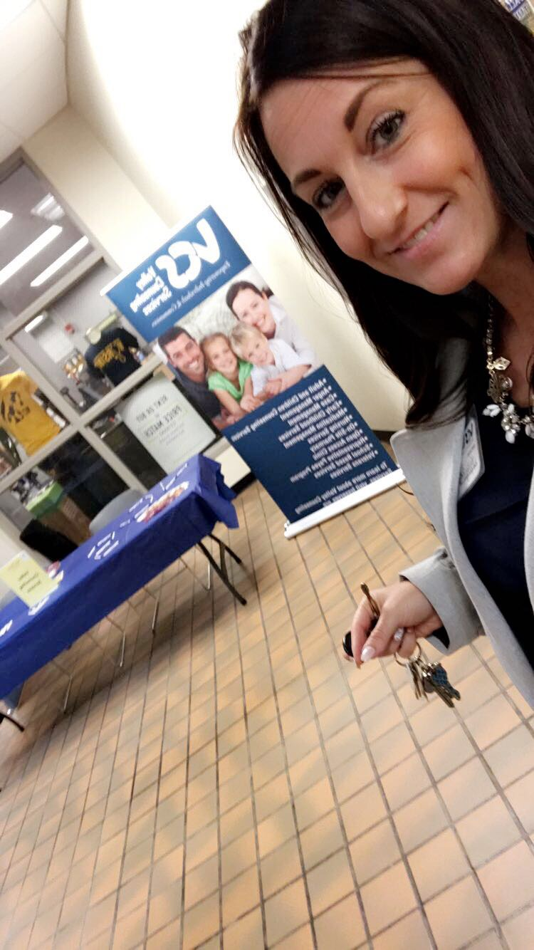
Clinician Researcher- Practitioner
Master’s in Clinical Community Mental Health
LPCC
Accepted into Doctoral Program in 2011
Remained in the field due to my investment in my work with the FRM and RTC
Studied the clinical process, as well as my children and family’s outcomes(positive & negative), collected variables- which lead to:
Prognosis Factors
Critical Impact Points
Customized Clinical Treatment Folders
Predictive Analytics
Continuum of Compentencies
Micro to Macro application of FRM

Slide 3
Who’s Who?
Direct Care Staff
Clinicians & Clinical Directors
Program Managers
Residential Administrators
Community Mental Health Providers
Executives
Insurance Companies
Others?

Slide 4
Parking Lot

Slide 5
Residential Treatment Service Delivery & Collaboration
Efficiency is doing the thing right
Effectiveness is doing the right thing

Slide 6
The Big Picture
A Residential Treatment Center that utilizes a model is more organized, synchronized, and effective in its services delivery and outcomes.
Trained Providers provide better services.
Trained Providers are better at engagement, treatment planning, and service delivery, which results in more positive outcomes for the child and family.
A Trained system of care uses its resources wisely and effectively, optimizing its outcomes.
A trained company can provide data to its reimbursement sources, documenting its effectiveness.

Slide 7
Today’s Workshop
Introduction
Creation of the Model
Purpose of the Model
The Family Reunification Model ©
Overview Features
Micro to Macro Applications
Questions?

Slide 8
Who
Training in the FRM© has micro to macro level implications to enhance service delivery in effort to improve outcomes for children and families.
Who can benefit:
Children and families
Direct Care Staff
RTC Program Administrators, Managers, Clinical Supervisors
Community Collaborators
Community Stakeholders

Slide 9
Why? With lack of a comprehensive and coherent clinical treatment model, the reunification process (and its outcome) is often vulnerable and varied. Variability in the ability, professionalism, clinical understanding and skill set of the caseworker (s), counselor (s), Service Providers, and Decision Makers, in addition to incongruent Organizational Policy and Procedure, creates unnecessary inconsistency. This leaves treatment outcomes vulnerable and varied for the children and families we serve.

Slide 10
How will the FRM model help children and families?
Consumers need a clear understanding of the process.
Consumers benefit from visuals, metaphors, past success stories (Eells, 1997; Meier, 1999, 2003).
Consumers benefit from planned treatment; they should be certain as to what is expected of them and what their family can expect to experience.
Consumers are more likely to be engaged in services when they are an active, invested participant (Lindqvist,2010).

Slide 11
How will the FRM model help children and families?
Consumers can speak a common language.
Visual Model is like Map Quest; Start, finish, and specific directions in between to get to the destination.
Knowing what to expect helps families plan ahead.
Knowing what to expect can empower children and families to engage.
The Treatment Process won’t be something that is “done to them” or “happens to them”; but rather a process they participate in and, ideally, take ownership of.

Slide 12
Where
Specifically designed for RTCs, particularly those with multi-systemic involvement.
But can be applicable for training community mental health providers and collaborating providers as well.

Slide 13
The Family Reunification Model: A Logic Model
Goal: Provide a Standardized, Coherent Conceptual Framework for Family Reunification with High Risk Families
Purpose: Improve Outcomes for Children & Families

Slide 14
The Family Reunification Model © 8 Phases I. Pre-Admission II. Admission III. Stabilization/Assessment IV. Mediation/ Mitigation V: Visitation/ Therapeutic Reframe VI: Transfer VII: Detachment/ Individuation VIII: Discharge
© Copyright 2010

Slide 15
Comprehensive Features A. Model Illustration B. Trauma Informed & Trauma Focused Treatment Folder Options C. Parent Packet D. Measures of Progress {Quadrants of Progress} E. Metaphors F. Safety Plan G. LOC Tool H. Wrap Plan I. Family Therapy rules J. Family Therapy Process K. Visitation Sheets L. WJH Sheet M. Behavior Mod Sample Sheet N. Behavior Mod Charting O. Sample Quarterly Progress Report P. Admission Criteria Q. Discharge Criteria R. Family Reunification Developmental Process Best Practices S. Critical Impact Points T. Prognosis Factors

Slide 16
Model Features
Education
Engagement
Treatment Center Handbook
LOC
Parent Packet
FRM Model Visual, Stages, Explanation, Expectation Packets & Info Sessions
Measure of Progress
Admission Criteria
Parent Packet
WJH sheets
Visitation Sheets
Behavior Plans
Safety Plans
Measure of Progress
Quarterly Progress
Discharge Criteria

Slide 17
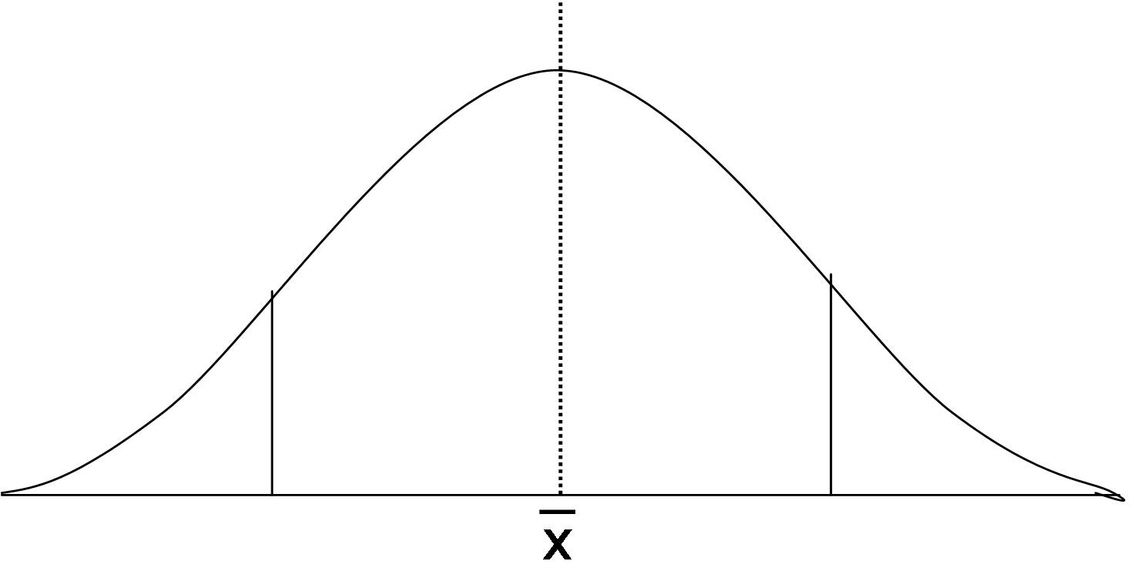
The Family Reunification Model ©
Start to finish visual aide
Externalizing the problem technique, for targeted team focus
Purposeful collaboration
Attention to critical impact points & junctures

Slide 18
Reunifying a Family is like teaching the child and family to ride a bike. Doing the right thing Realize we are providing a bike (services) -Find a bike that fits (services/providers) -Getting on the bike (motivation/commitment) -Training wheels (Supportive Assistance) -Learning to ride without training wheels (transfer of skills) -Staying on the path (maintenance) -Riding together in Unison at the same rate (Discharge)

Slide 19
Using Hi-Fidelity Wraparound to drive the process is like riding in an SUV full of TX Providers on the Journey to Reunification Doing the Thing Right (Efficiency) -Determine who has been driving? -Who should be driving? -Are they safe/legal driver? -Have we agreed on where we are going? -What kind of route are we going to take? -What kind of resources are in our car? -Who are we kicking out first? -Is everyone in the car that needs to be?

Slide 20
Micro to Macro
Program Managers, Administrators
Clinicians & Clinical Providers
Direct Care Staff
Kids & Families
Community Stakeholders, Funding Sources

Slide 21
Questions, Comments

Slide 22
Contact Information
Kelly N. Bako, MSEd., LPCC
Phone: 330.509.9640
Email: thefamilyreunificationmodel@gmail.com
Website: http://www.thefamilyreunificationmodel.com/
LinkedIn: https://www.linkedin.com/in/kelly-bako-65055a56/
Facebook: https://www.facebook.com/kellybakothesource/

